Slide 1
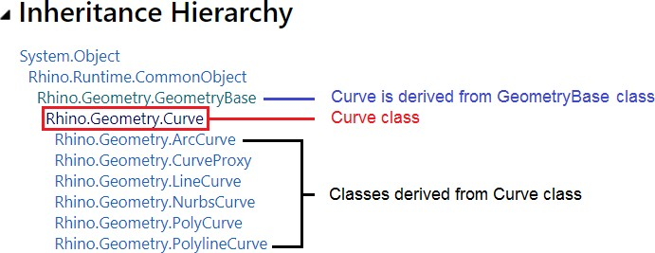
3_3: Geometry classes
Just like structures, classes enable defining custom types by grouping other types together along with some custom methods and events. A class is like a blueprint that encapsulates the data and the behavior of the user-defined type. But, unlike structures, classes allow inheritance which enables defining a hierarchy of types that starts with a generic type and branches into more specific types. For example, the Curve class in RhinoCommon branches into specialized curve types such as ArcCurve and NurbsCurve. The following diagram shows the hierarchy of the Curve class:
Most geometry classes are derived from the GeometryBase class. The following diagram shows the hierarchy of these classes.

Slide 2
GeometryBase
AnnotationBase
 | Dimension
 |  | AngularDimension
 |  | Centermark
 |  | LinearDimension
 |  | OrdinateDimension
 |  | RadialDimension
 | Leader
TextEntity
Abstract class (cannot create an instance of an abstract class)
Abstract class derived from AnnotationBase
Classes derived from Dimension class
Classes derived from AnnotationBase class
Brep BrepLoop Curve
ArcCurve
CurveProxy
 | BrepEdge
 | BrepTrim
LineCurve
NurbsCurve
PolyCurve
PolylineCurve
Abstract Curve class
Classes derived from Curve base class
DetailView Hatch
InstanceDefinitionGeometry
InstanceReferenceGeometry Light
Mesh MorphControl Point
BrepVertex
Class derived from Point base class
Point3dGrid PointCloud Surface
Extrusion NurbsSurface PlaneSurface
Abstract Surface class
ClippingPlaneSurface
Classes derived from Surface base class
RevSurface SumSurface SurfaceProxy
BrepFace
TextDot

Slide 3
3_3_1: Curves
The RhinoCommon SDK has the abstract Rhino.Geometry.Curve class that provides a rich set of functionality across all curves. There are many classes derived from the parent Curve class and we will learn about how to create and manipulate them. The following is a list of the classes derived from the Curve class.
Curve Types | Notes
ArcCurve | Used to create arcs and circles
LineCurve | Used to create lines
NurbsCurve | Used to create free form curves
PolyCurves | A curve that has multiple segments joined together
PolylineCurve | A curve that has multiple lines joined together
CurveProxy | Cannot instantiate an instance of it. Both BrepEdge and BrepTrim types are derived from the CurveProxy class.

Slide 4
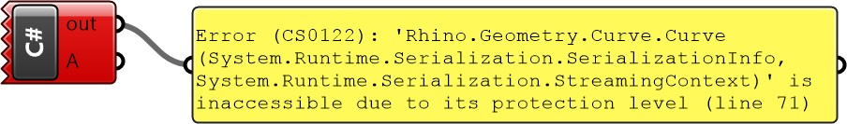
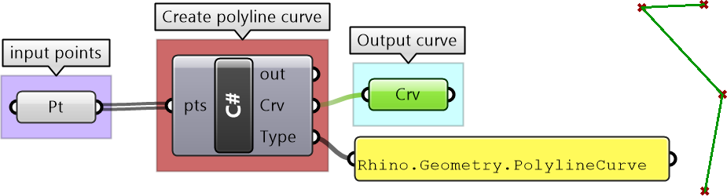
You can instantiate an instance of most of the classes above. However, there are some classes that you cannot instantiate. Those are usually up in the hierarchy such as the GeometryBase, Curve and Surface. Those are called abstract classes.
Abstract Classes: The “GeometryBase” in RhinoCommon is one example of an abstract class. You cannot create an object or instantiate an instance of an abstract class. The purpose is to define common data and functionality that all derived classes can share.
Base Classes: refer to parent classes that define common functionality for the classes that are derived from them. The Curve class is an example of a base class that also happens to be an abstract (cannot instantiate an object from it). Base classes do not have to be abstract though.
private void RunScript(ref object A) {
//ERROR: attempt to create an instance of the abstract "Curve" class Rhino.Geometry.Curve crv = new Rhino.Geometry.Curve();
}
Derived Classes: inherit the members of a class they are derived from and add their own specific functionality and implementation. The NurbsCurve is an example of a derived class from the Curve class. The NurbsCurve can use all members in Curve class methods. The same is true for all other classes derived from Curve, such as ArcCurve, PolyCurve. The following example shows how to create a new instance of the PolylineCurve class.
private void RunScript(List<Point3d> pts, int degree, ref object Crv, ref object Type) {
//Declare and create a new instance of a polyline curve from points var crv = new Rhino.Geometry.PolylineCurve(pts); //Assign curve to A output Crv = crv; //Assign curve type to B output Type = crv.GetType();
}

Slide 5
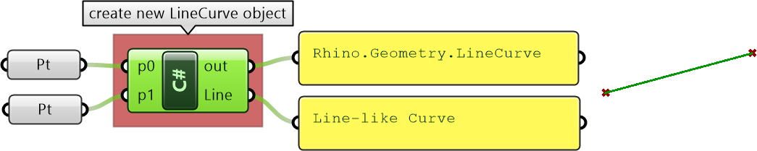
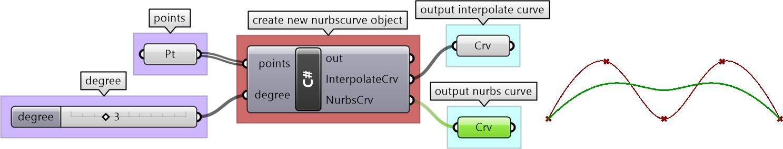
The most common way to create an instance of a class is to use the new keyword when declaring the object.
private void RunScript( Point3d p0, Point3d p1, ref object Line ) {
//Create an instance of a point object and unset var lineCurve = new Rhino.Geometry.LineCurve(p0, p1); Print(lineCurve.ToString()); Line = lineCurve
}
There is another common way to create instances of classes. That is to use special methods in some classes to help create and initialize a new instance of an object. For example, the Curve class has static methods to create a variety of curve types as in the following example. Notice that you do not need to use new in this case.
private void RunScript(List<Point3d> points, int degree, ref object A, ref object B) {
//Declare a curve variable Rhino.Geometry.Curve inter_crv = default(Rhino.Geometry.Curve); //Create new instance of a curve from interpolate points inter_crv = Rhino.Geometry.Curve.CreateInterpolatedCurve(points, degree); //Declare a curve variable Rhino.Geometry.Curve nurbs_crv = default(Rhino.Geometry.Curve); //Create new instance of a curve from control points nurbs_crv = Rhino.Geometry.Curve.CreateControlPointCurve(points, degree); //Assign output A = inter_crv; B = nurbs_crv;
}
The following table summarizes the different ways to create new instances of objects, which applied to both class and structure types.

Slide 6
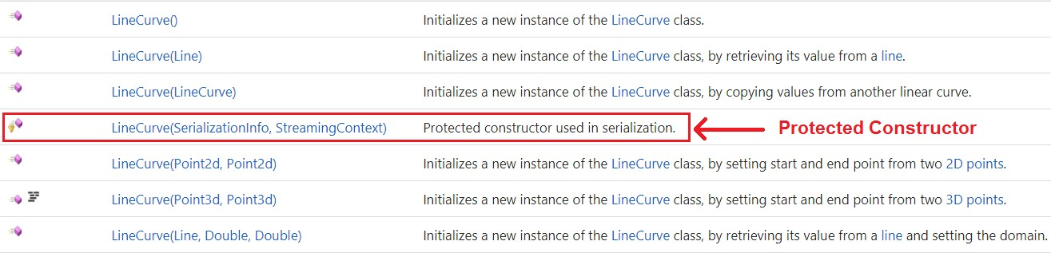
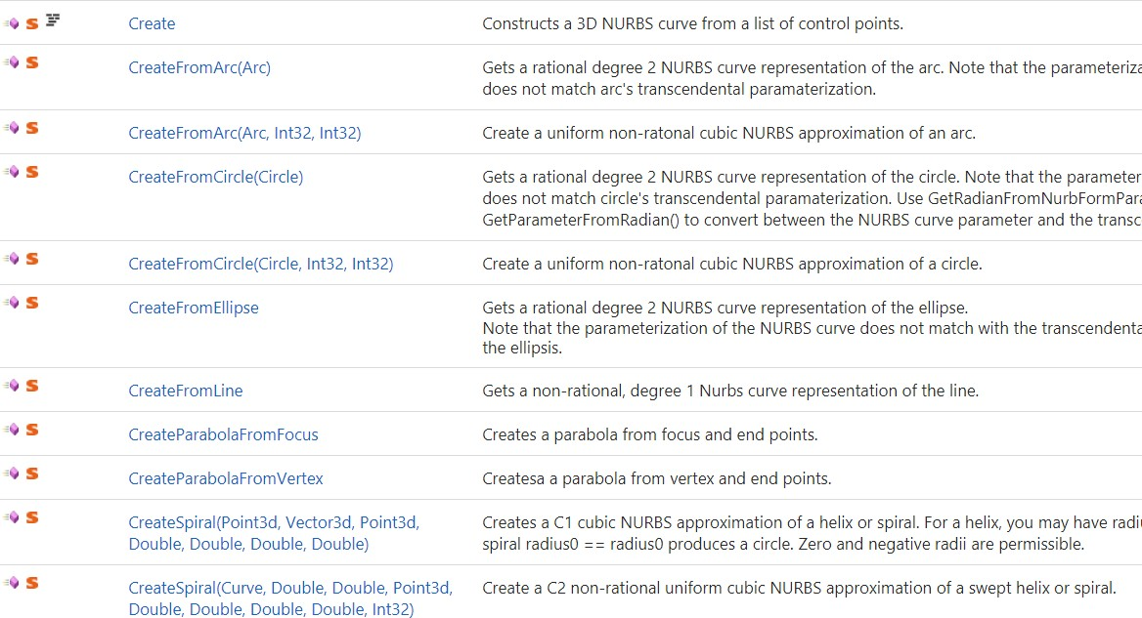
DIfferent way to create a new instance of an object
1- Use the class constructor
Need to use the new keyword. For example, the following creates a line from two points. Rhino.Geometry.LineCurve lc = new Rhino.Geometry.LineCurve(p0, p1); Note that each class may have a number of constructors that include different sets of parameters. For example the LineCurve class has the following constructors: Many times, there are “protected” constructors. Those are used internally by the class and you cannot use them to create a new instance of the object with them. They are basically locked. The LineCurve class has one marked in the image above.
2- Use the class static Create methods
Some classes include a Create method to generate a new instance of the class. Here is an example: Rhino.Geometry.NurbsCurve nc = NurbsCurve.Create(isPeriodic, degree, controlPoints); You can find these methods in the RhinoCommon help when you navigate the class “members”. Here are different ways to create a NurbsCurve for example and how they appear in the help.
3- Use the static Create methods of the parent class

Slide 7
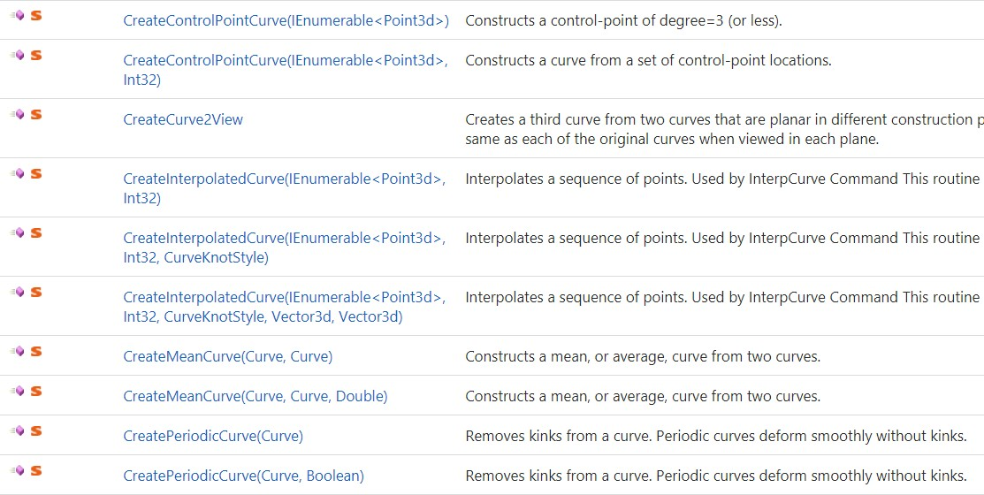

There are times when the parent class has “Create” methods that can be used to instantiate an instance of the derived class. For example, the Curve class has few static methods that a derived class like NurbsCurve can use as in the example: Rhino.Geometry.Curve crv= Curve.CreateControlPointCurve(controlPoints, degree); Rhino.Geometry.NurbsCurve nc = crv as Rhino.Geometry.NurbsCurve; For the full set of the Curve Create methods, check the RhinoCommon documentation. Here is an example of a few of them.
4- Use the return value of a function
Class methods return values and sometimes those are new instances of objects. For example the Offset method in the Curve class returns a new array of curves that is the result of the offset. Curve[ ] offsetCurves = x.Offset( Plane.WorldXY, 1.4, 0.01, CurveOffsetCornerStyle.None );
Once you create an instance of a class or a structure, you will be able to see all class methods and properties through the auto-complete feature. When you start filling the method parameters, the auto-complete will show you which parameter you are at and its type. This is a great way to navigate all available methods for each class and be reminded of what parameters are needed. Here is an example from a Point3d structure. Note that you don’t always get access to all the methods via the auto-complete. For the complete list of properties, operations and methods of each class, you should use the RhinoCommon help file.

Slide 8
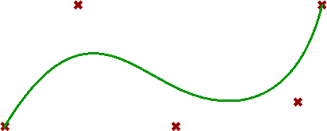
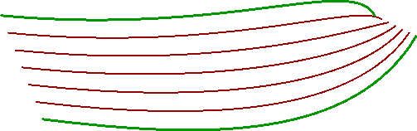
3_3_1: Curves
Create curve objects:
One way to create a curve object is to use the create methods available as static methods in the parent Rhino.Geometry.Curve class. Here is an example.
Create an instance of a NurbsCurve from control points and degree
Curve nc = Rhino.Geometry.Curve.CreateControlPointCurve(points, degree);
Create an array of tween curves using two input curves and a the number of tween curves
//Declare a variable of type Curve Curve[ ] tweenCurves = null; //Create an array of tween curves tweenCurves = Rhino.Geometry.Curve.CreateTweenCurves(curve0, curve1, count, 0.01);

Slide 9
Curves
Explicit
y = f(x) // y is a function of x
y = x^2
Implicit
x = f(t)
y = f(t)
y
y
x
x
p(t) = (x_{t}, y_{t})
y
t
t
x

Slide 10
Curves
Point at curve that is an implicit function
Find a point for t
Implicit
x = f(t)
y = f(t)
p(t) = (x_{t}, y_{t})
y
t
x

Slide 11
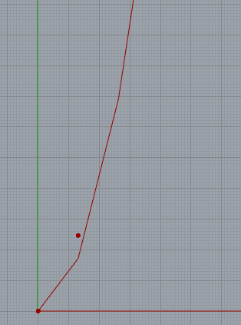
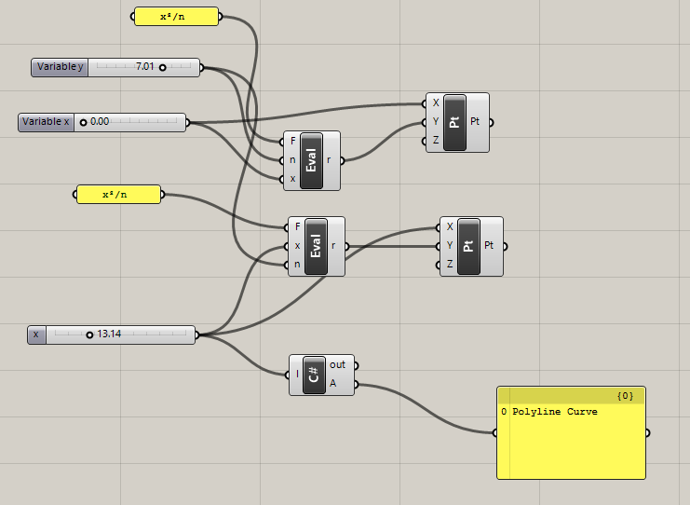
Explicit vs implicit curve functions

Slide 12
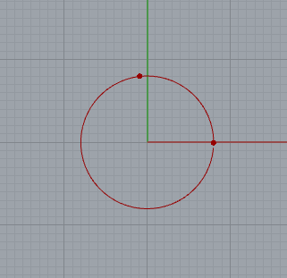
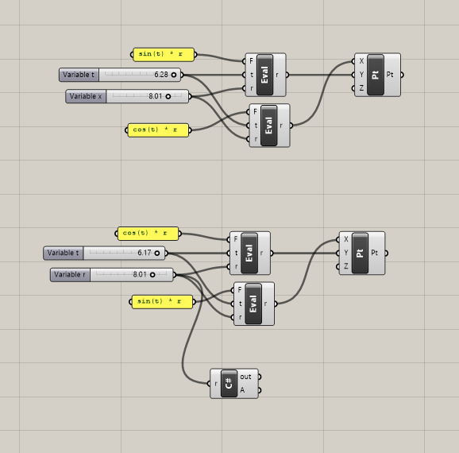
Explicit vs implicit curve functions - circle
>>

Slide 13
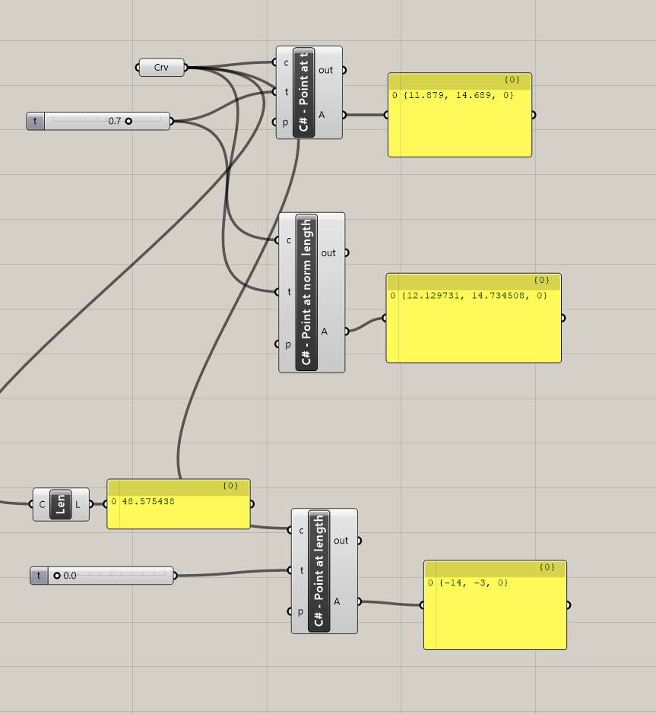
Point at parameter
>>

Slide 14
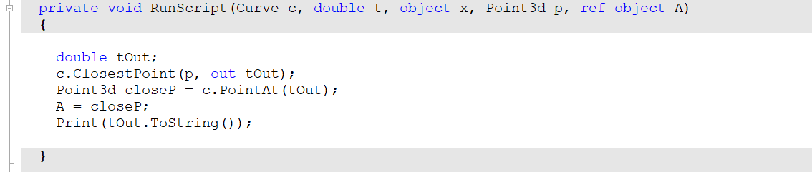
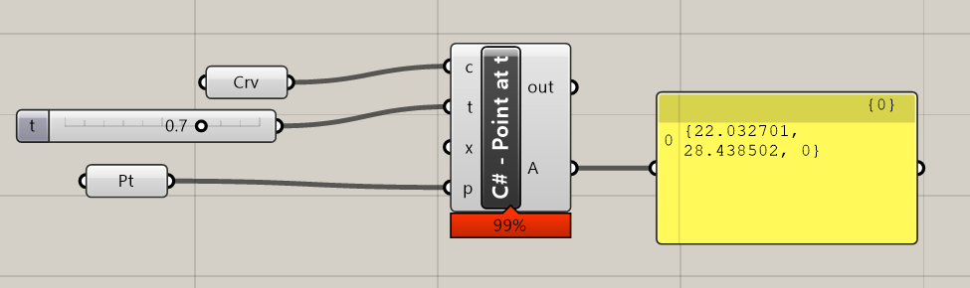
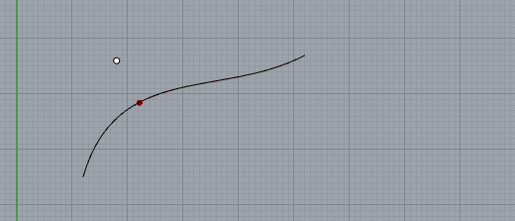
Curve functions – closest point
>>

Slide 15
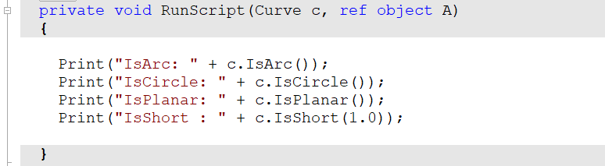
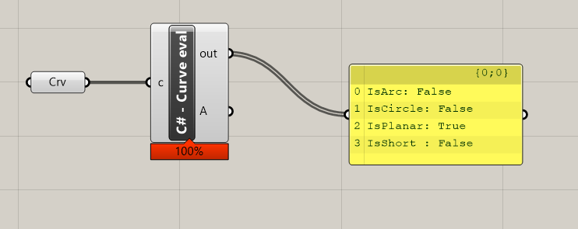
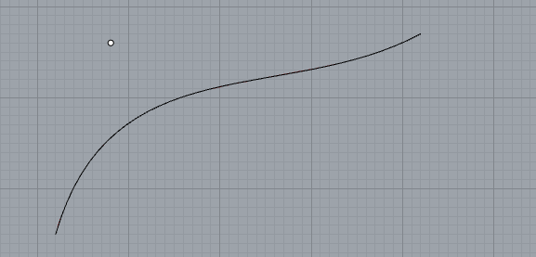
Curve functions – evaluate
>>

Slide 16

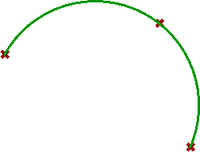
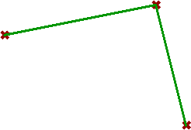
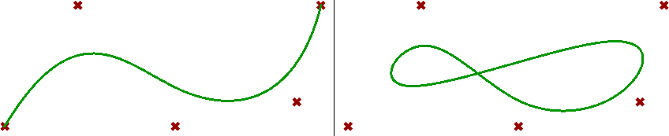
Another way to create new curves is to use the constructor of the curve with the new keyword. The following are examples to create different types of curves using the constructor or the Create method in the class. You can reference the RhinoCommon help for more details about the constructors of each one of the derived curve classes.
Declare and initialize 3 new points
Point3d p0 = new Point3d(0, 0, 0); Point3d p1 = new Point3d(5, 1, 0); Point3d p2 = new Point3d(6, -3, 0);
Create an instance of a LineCurve using the class constructor and new keyword
//Create an instance of an LineCurve LineCurve line = new LineCurve(p0, p1);
Create an instance of a ArcCurve using the class constructor and new keyword
//Create an instance of a lightweight Arc to pass to the // constructor of the ArchCurve class Arc arc = new Arc(p0, p1, p2); //Create a new instance of ArcCurve ArcCurve arcCurve = new ArcCurve(arc);
Create an instance of a PolylineCurve using the class constructor and new keyword
//Put the 3 points in a list Point3d[ ] pointList = {p0, p1, p2}; //Create an instance of an PolylineCurve PolylineCurve polyline = new PolylineCurve(pointList);
Create one open and one closed (periodic) curves using the Create function of the NurbsCurve class
bool isPeriodic = false; int degree = 3; NurbsCurve openCurve = NurbsCurve.Create(isPeriodic , degree, pointList);
>>
>>
>>
isPeriodic = true;
NurbsCurve periodicCurve = NurbsCurve.Create(isPeriodic , degree, pointList);

Slide 17
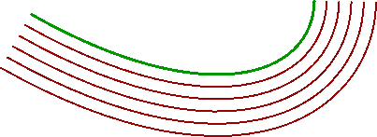
Curves can also be the return value of a method. For example offsetting a given curve creates one or more new curves. Also the surface IsoCurve method returns an instance of a curve.
Multiple offset of curve
private void RunScript(Curve crv, int num, double dis, double tol, Plane plane) { //Declare the list of curve List<Curve> crvs = new List<Curve>(); Curve lastCurve = crv; for (int i = 1; i <= num; i++) { Curve[ ] curveArray = last_crv.Offset(plane, dis, tol, CurveOffsetCornerStyle.None); //Ignore if output is multiple offset curves if (crv.IsValid && curveArray.Count() == 1) { //append offset curve to array crvs.Add(curveArray[0]); //update the next curve to offset lastCUrve = curveArray[0]; } else break; } }
>>

Slide 18

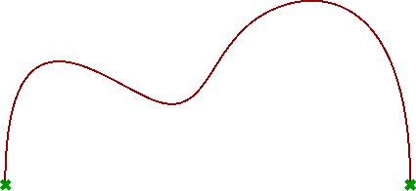
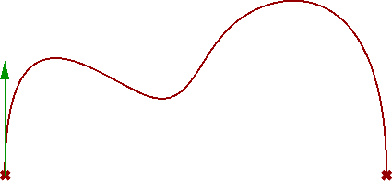
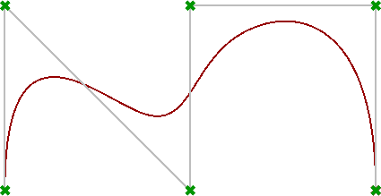
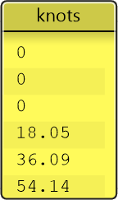
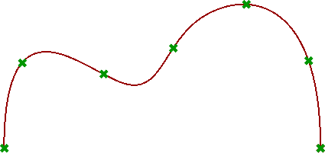
Curve methods:
Each class can define methods that help navigate the data of the class and extract some relevant information. For example, you might want to find the endpoints of a curve, find the tangent at some point, get a list of control points or divide the curve. The AutoComplete helps to quickly navigate and access these methods, but you can also find the full description in the RhinoCommon help.
Keep in mind that a derived class such as NurbsCurve can access not only its own methods, but also the methods of the classes it was derived from. Therefore an instance of a NurbsCurve, can access the NurbsCurve methods and the Curve methods as well. The methods that are defined under the Curve are available to all of the classes derived from the Curve class such as LineCurve, ArcCurve, NurbsCurve, etc. Here are a few examples of curve methods.
Some of the Curve and NurbsCurve methods
//Get the domain or interval of the curve Interval domain = crv.Domain;
//Get the start and end points of a curve Point3d startPoint = crv.PointAtStart; Point3d endPoint = crv.PointAtEnd;
//Get the tangent at start of a curve Vector3d startTangent = crv.TangentAtStart;
//Get the control points of a NurbsCurve (nc) List<Point3d> cpList = new List<Point3d>(); int count = nc.Points.Count; //Loop to get all cv points for (int i = 0; i <= count - 1; i++) { ControlPoint cp = nc.Points[i]; cpList.Add(cp.Location); }
//Get the knot list of a NurbsCurve (nc) List<double> knotList = new List<double>(); int count = nc.Points.Count; //Loop to get all knots values for (int i = 0; i <= count - 1; i++) { double knot = nc.Knots[i]; knotList.Add(knot); }
//Divide curve (crv) by number (num) //Declare an array of points Point3d[ ] points = { }; //Divide the curve by number crv.DivideByCount(num, true, out points);
>>
>>
>>
>>

Slide 19
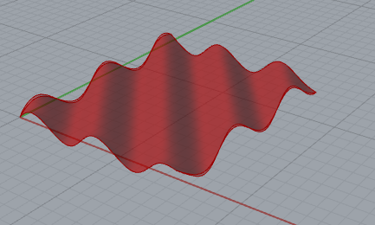
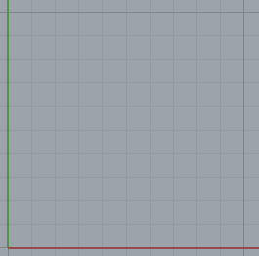
Surfaces
Explicit
z = f_{s}(x, y)
Implicit
x = f_{x}(u, v)
y = f_{y}(u, v)
z = f_{z}(u, v)
v
u

Slide 20

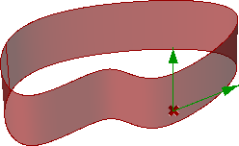
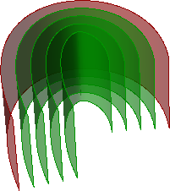
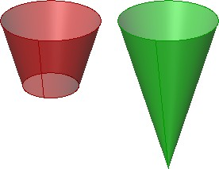
>>
Examples of the Surface and NurbsSurface methods
Surface srf = … //from input //Check if the input surface is closed in the u or v direction bool isClosedU = srf.IsClosed(0); bool isClosedV = srf.IsClosed(1); //Check if the surface is planar at zero tolerance bool isPlanar = srf.IsPlanar();
Surface srf = … //from input double u = 0.5; double v = 0.5; //Declare and instantiate the evaluation point and derivative vectors Point3d evalPt = new Point3d(Point3d.Unset); Vector3d[ ] derivatives = {}; //Evaluate the surface and extract the first derivative to get tangents srf.Evaluate(u, v, 1, out evalPt, out derivatives); Vector3d tanU = derivatives[0]; Vector3d tanV = derivatives[1];
//Declare the list of surfaces List<Surface> srfs = new List<Surface>(); Surface lastSrf = srf; for (int i = 1; i <= num; i++) {t Surface offset_srf = last_srf.Offset(dis, tol); if (srf.IsValid) { //append offset surface to array srfs.Add(offset_srf); //update the next curve to offset lastSrf = offset_srf; } else break; }
//Declare and instantiate an axis and a curve Line axis = new Line (Point3d.Origin, new Point3d(0, 0, 10)); LineCurve crv = new LineCurve(new Point3d(2, 0, 0), new Point3d(3.5, 0, 5)); //Create surface of revolution RevSurface revSrf = RevSurface.Create(crv, axis); //Try to get a Cone Cone cone; if( revSrf.TryGetCone(out cone)) Print(“Cone was successfully create from surface”);
>>
>>
>>
3_3_3: Meshes
Meshes represent a geometry class that is defined by faces and vertices. The mesh data structure basically includes a list of vertex locations, faces that describe vertices connections and normal of vertices and faces. More specifically, the geometry lists of a mesh class include the following.

Slide 21

Curves can also be the return value of a method. For example offsetting a given curve creates one or more new curves. Also the surface IsoCurve method returns an instance of a curve.
Extract iso-curve from a surface. A new instance of a curve is the return value of a method
//srf = input surface, p = input parameter var isoCurve = srf.IsoCurve(0, p);
>>

Slide 22
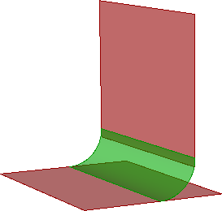
3_3_2: Surfaces
There are many surface classes derived from the abstract Rhino.Geometry.Surface class. The Surface class provides common functionality among all of the derived types. The following is a list of the surface classes and a summary description.
Surface derived Types | Notes
Extrusion | Represents surfaces from extrusion. It is much lighter than a NurbsSurface
NurbsSurface | Used to create free form surfaces
PlaneSurface | Used to create planar surfaces
RevSurface | Represents a surface of revolution
SumSurface | Represents a sum surface, or an extrusion of a curve along a curved path.
SurfaceProxy | Cannot instantiate an instance of it. Provides a base class to brep faces and other surface proxies.
Create surface objects:
One way to create surfaces is by using the static methods in the Rhino.Geometry.Surface
class that start with the keyword Create. Here are some of these create methods..
The Create methods in Rhino.Geometry.Surface class
CreateExtrusion | Constructs a surface by extruding a curve along a vector.
CreateExtrusionToPoint | Constructs a surface by extruding a curve to a point.
CreatePeriodicSurface | Constructs a periodic surface from a base surface and a direction.
CreateRollingBallFillet | Constructs a rolling ball fillet between two surfaces.
CreateSoftEditSurface | Creates a soft edited surface from an existing surface using a smooth field of influence.
The following is an example to create a fillet surface between 2 input surfaces given some radius and tolerance.
private void RunScript(Surface srfA, Surface srfB, double radius, double tol, ref object A) { //Declare an array of surfaces Surface[ ] surfaces = {}; //Check for a valid input if (srfA != null && srfB != null) { //Create fillet surfaces surfaces = Surface.CreateRollingBallFillet(srfA, srfB, radius, tol); } }
However, the most common way to create a new instance of a derived surface type is to either use the constructor (with new keyword), or the Create method of the derived surface class.
Here are a couple examples that show how to create instances from different surface types.

Slide 23
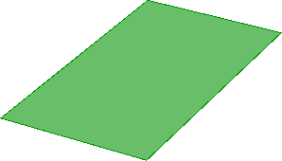
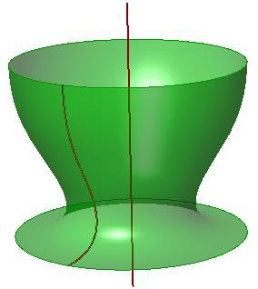
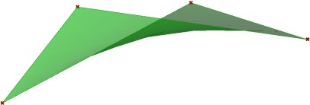
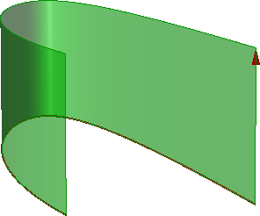
Create an instance of a PlaneSurface using the constructor and new keyword
var plane = Plane.WorldXY; var x_interval = new Interval(1.0, 3.5); var y_interval = new Interval(2.0, 6.0); //Create planar surface var planeSrf = new PlaneSurface(plane, x_interval, y_interval);
Create an instance of a RevSurface from a line and a profile curve
RevCurve revCrv = … //from input Line revAxis = … //from input //Create surface of revolution var revSrf = RevSurface.Create(revCrv, revAxis);
Create an instance of a NurbsSurface from a list of control points
List<Point3d> points = … //from input //Create nurbs surface from control points NurbsSurface ns = null; ns = NurbsSurface.CreateThroughPoints(points, 2, 2, 1, 1, false, false);
Create an instance of a NurbsSurface from extruding a curve in certain direction
Curve cv = … //from input Vector3d dir = … //from input //Create a nurbs surface from extruding a curve in some dir var nSrf = NurbsSurface.CreateExtrusion(crv, dir); //Create an extrusion from extruding a curve in some dir var ex = Extrusion.Create(crv, 10, false); //Note that in Grasshopper 1.0 there is no support to extrusion objects and hence the output within GH is converted to a nurbs surface. The only way to bake an Extrusion instance is to add the object to the active document from within the scripting component as in the following Rhino.RhinoDoc.ActiveDoc.Objects.AddExtrusion(ex);
Surface methods:
Surface methods help edit and extract information about the surface object. For example, you might want to learn if the surface is closed or if it is planar. You might need to evaluate the surface at some parameter to calculate points on the surface, or get its bounding box. There are also methods to extract a lightweight geometry out of the surface. They start with “Try” keyword. For example, you might have a RevSurface that is actually a portion of a torus. In that case, you can call TryGetTorus. All these methods and many more can be accessed through the surface methods. A full list of these methods is documented in the RhinoCommon SDK documentation.

